Slide 1
Git & Github Workshop: its not just for programmers

Slide 3
Why is learning git important for scientists?
Git facilitates documentation & sharing/collaborating
Both of these are important in science!

Slide 4
Why is learning git important for scientists? Documentation
Version-control for code = lab notebook for experiments
It ensure consistency within the experiment and facilitates reproducible results
Data collection & experiment
Data processing and analysis
?
We are pretty good at recording changes here

Slide 5
Why is learning git important for scientists? Sharing/Collaboration
Sharing codes are difficult through traditional means
Emailing someone you don’t personally know is a high barrier.
Someone can follow your codes (like following a blog)
Facilitate collaboration on Github/other-remote-hosts
Someone can follow your codes (like following a blog)
We get to see whether we want to incorporate new changes or not
Encourages open source and open science
Open science is a huge topic, and there are some pros and cons
Openness to your code is generally a good idea.

Slide 6
What is the goal of this workshop?
Start using git to document (version-control) changes in your code
Setup and start using Github to share your code and collaborate

Slide 7
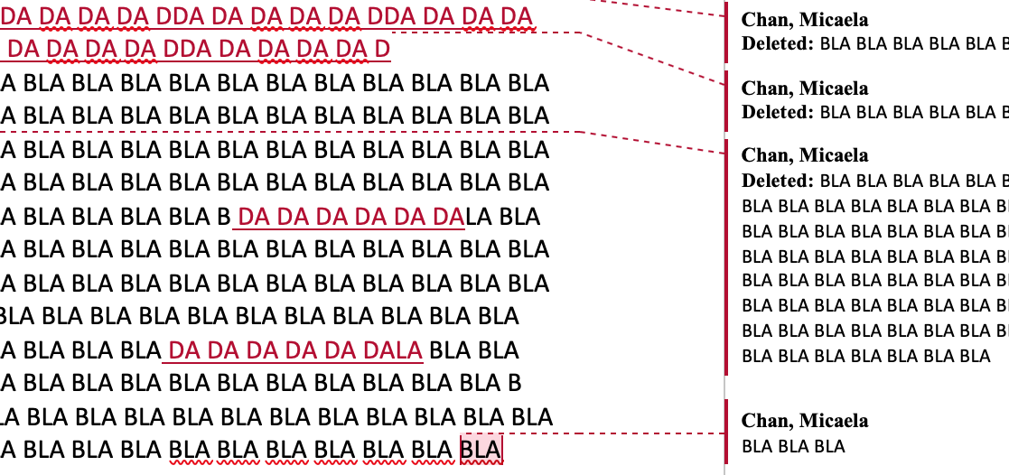
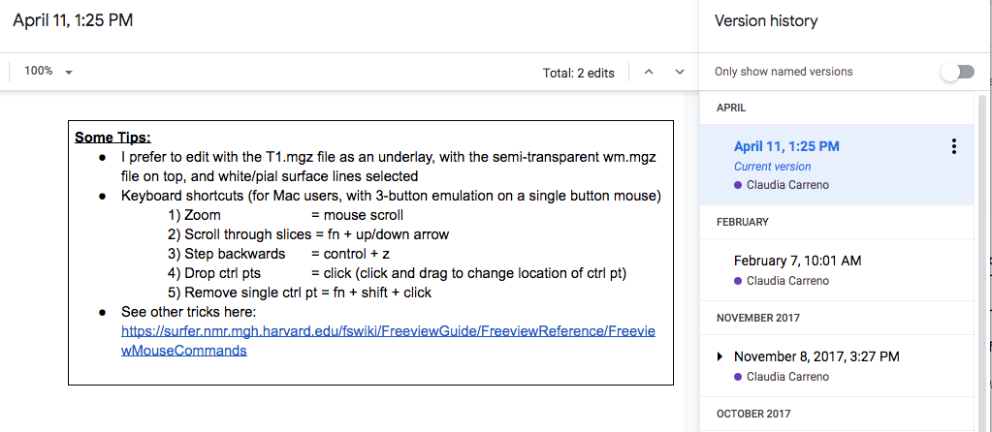
Git: Documentation of code
What do we do for documents?
Track Changes (Microsoft Word)
Changes are highlighted, shows who did it (ideally…)
Version History (Google-doc)
All changes are recorded, and you can go back to see how things were like before a certain change.

Slide 8
Git: Documentation of code
Git track changes & gives you a version history!
Why doesn’t everyone use git?
Incorporating Git into your workflow takes some getting used to.
Git needs you to tell it “what” to track and “when” to track

Slide 9
What is being tracked?
base document
changes
Don’t think of it as multiple documents, but base document + sets of changes

Slide 10
Separate changes can be made, and reocrded
Change 1
Change 2

Slide 11
Separate changes can be incorporated together
Incorporate Change 1
Incorporate Change 2

Slide 12
1. Setting up git
1.1 - Download git
1.2 - Configure git
Username & email
Line break
Setup default text editor

Slide 13
2. Creating a repository What is a repository?
Repository (repo):
An index that tracks changes of a folder (in a .git/ folder).
Directory
Notes:
https://en.wikipedia.org/wiki/Drum_memory
Index/database are just collection of data

Slide 14
2. Creating a repository > git init
2.1 – Create a directory in your Desktop
2.2 – Create a repository (stores the versions of your files)
> mkdir ~/Desktop/workdir
> cd ~/Desktop/workdir
> git init

Slide 15
3. Tracking Changes > git add, commit
git commit:
Tell git to document the changes you “added” (i.e., the files in the staging area)
Mandatory commit message that you must provide to explain what changes were made.
git add:
Tells git which files’ you want to track.
Formally, this is call adding a file to the “index/staging area”.

Slide 16
3. Tracking Changes > git add, commit
3.1 – Adding new files/modification to staging area
3.2 – Saving these changes to the repository
> touch foo.txt
> git add foo.txt
> git commit –m “Add foo.txt to repo”

Slide 17
3. Tracking Changes > git add, commit
BONUS – Checking what has changed before add/commit
> echo hello >> foo.txt
> git diff
> git add –A
> git commit
> git log

Slide 18
File versions let us go back in time!
What is wrong with just using `my_script_version100.sh`?
Codes that worked last week don’t work anymore!?
Codes crashed after someone else changed it!?
(don’t murder them)
New lab member joins the lab, inherit a project started 4 years ago by an ex-lab-member……
Notes:
Give example from gitlab

Slide 19
4. Exploring History > git diff & show
4.1 – Difference between current file and N commit ago
> git diff HEAD
> git diff HEAD~1
> git diff efakb1
4.2 – What was done in ____ commit?
> commit show HEAD~1 foo.txt
Identifier is different for every commit/repo, use git log to check.

Slide 20
5. Reverting to a previous commit > git checkout
5.1 – Going back to a specific version of a file
> git checkout HEAD~1 foo.txt
> cat foo.txt
> git checkout HEAD foo.txt
5.2 Going back to an entire commit - Detached HEAD (CAUTION)
> git checkout HEAD~1
IF you checkout a previous commit without first committing your current state, then anything not committed would be lost!!!
> git checkout HEAD

Slide 21
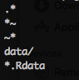
6. Telling git to ignore certain files .gitignore
Sometimes we don’t want git to track a certain type of files
Temporary files (e.g., bla.m~, .bla.txt)
Big data files (e.g., huge_matrix.mat, pca_result.Rdata)
OS files (e.g., .DS_Store)
Use a .gitignore file
> touch ignore_this.txt
> echo ignore_this.txt >> .gitignore
> git add ignore_this.txt
NOTE: .gitignore can ignore an entire subdirectory.
Here is how a typical .gitignore file might look like:
This will now tell Git to not track ignore_this.txt

Slide 22
BREAK
This ends the brief intro to version control function in git.
There is a lot more, your preferred search-engine is your friend
Next up:
Github and its cousins to help your share your codes

Slide 23
Github and other remote hosts
A remote server that hosts repositories for free
Some other choices:

Slide 24


7. Putting codes on Github make a repo
7.1 – Create a remote repository
Go to https://github.com/<username>
Click Repositories tab
Click
Enter workdir as the Repository name, click
You now have a remote repository, but its empty!
An empty repo on github would have some instructions on how to populate it

Slide 25
7. Putting codes on Github > git remote add & push
7.2 – Push an existing repository from your local computer
> cd ~/Desktop/workdir
> git remote add origin https://github.com/<username>/workdir.git
> git push –u origin master
BONUS – SSH keys can be used for authentication instead of passwords.
https://help.github.com/en/enterprise/2.15/user/articles/adding-a-new-ssh-key-to-your-github-account

Slide 26
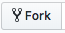
8. Getting a repository from Github fork & git clone
8.1 – Fork a repository (remote → remote)
Fork means copying someone's Github repo into your Github
Click the Fork icon near the top right corner
And then you should be redirected to a copy of the same repository in YOUR Github account
Now you should have a git_github_workshop repo in your github

Slide 27
8. Getting a repository from Github fork & git clone
8.2 – Cloning a repository (remote → lcoal)
Clone means you copy a remote repo onto your local computer
Clone the forked repository onto your local computer:
> git clone https://github.com/<username>/git_github_workshop.git ~/Desktop/git_github_workshop

Slide 28
9. Collaborating
9.1 – Setup a fake collaborator
Clone repo into a separate directory
> git clone https://github.com/<username>/workdir.git ~/Desktop/workdir_fake_collab
Make changes as fake collaborator and push to Github
> cd ~/Desktop/workdir_fake_collab
> touch foofoo.txt
> git add foofoo.txt
> git commit -m "Add foofoo.txt"
> git push origin master
Check what is on Github and workdir_fake_collab
Check what is in the original workdir

Slide 29
9. Collaborating > git fetch & git pull
9.2 – Implement the changes your fake collaborator made
Fetch the changes your fake collaborator pushed to Github onto your local computer.
> cd ~/Desktop/workdir
> git fetch
This does not change the files in your directory, but now you can check what your collaborator has changed
> git diff master origin/master
If you decided these are changes you want, you can pull the changes
> git pull

Slide 30
9. Collaborating Collaborating on Github
Adding collaborators in your Github repository
Click Settings
Click Collaborators and add them (they need to be on Github)
More advance way to collaborate (won't cover in detail)
Fork a repository you want to make changes
Clone it to your local computer
Make changes, add, commit & push it to your forked repo
Make a Pull Request in the original repository so the original owner can merge your request.
Ask me later ☺

